Slide 1
Proteomics
Tools en databases
Eiwit translocatie

Slide 2
Overzicht
Tools en databases
Annotatie en data kwaliteit
Eiwit translocatie
Predictie

Slide 3
Wat weet je al?
Welke tools/databases ken je?
Wat is het doel van deze tool/database?

Slide 4
De belangrijkste voor eiwitten
Uniprot (Swiss-prot+TrEMBL)
NCBI Protein (Refseq+Genbank)
PDB
Blast
ClustalO
Expasy tools

Slide 5
Database types
Primaire data
Secundaire data

Slide 6
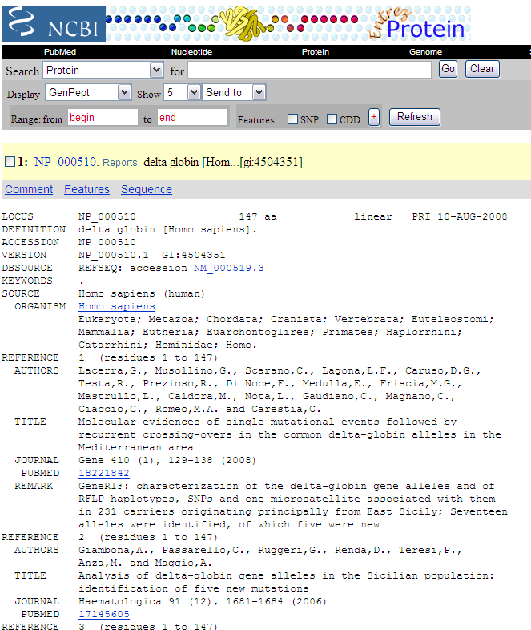
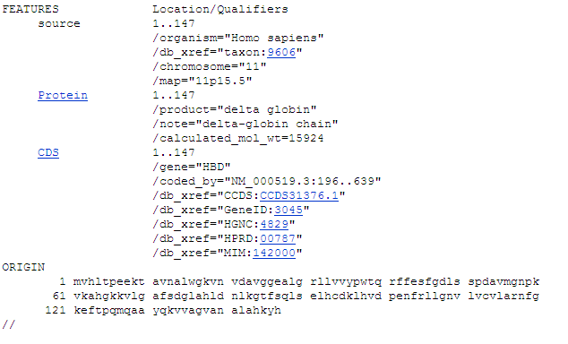
Primary data
raw experimental results, e.g. nucleotide sequence, scans of gene expression array
except for experimental errors, data is regarded as very reliable
nucleotide sequences:
reliability known, error rate documented
1 nucleotide error in 10,000 bases is standard
NP_000510 via http://www.ncbi.nlm.nih.gov/

Slide 7
Secondary (derived) data
e.g. collections of conserved protein sequence profiles, protein domains
based on the data existing at the time
gets out-dated if it gets not updated regularly
Problem: often related to research projects with a fixed duration

Slide 8
Protein Interaction databases
DIP
MINT
BIND

Slide 9
Protein family/domain databases
Pfam
Prosite
BLOCKS
Prints
ProDom

Slide 10
Structural databases
contain information on the structure of small molecules, proteins and DNA
such as:
RCSB, PDB, PDBe
MSD (macromolecular structure database)
CATH & SCOP

Slide 11
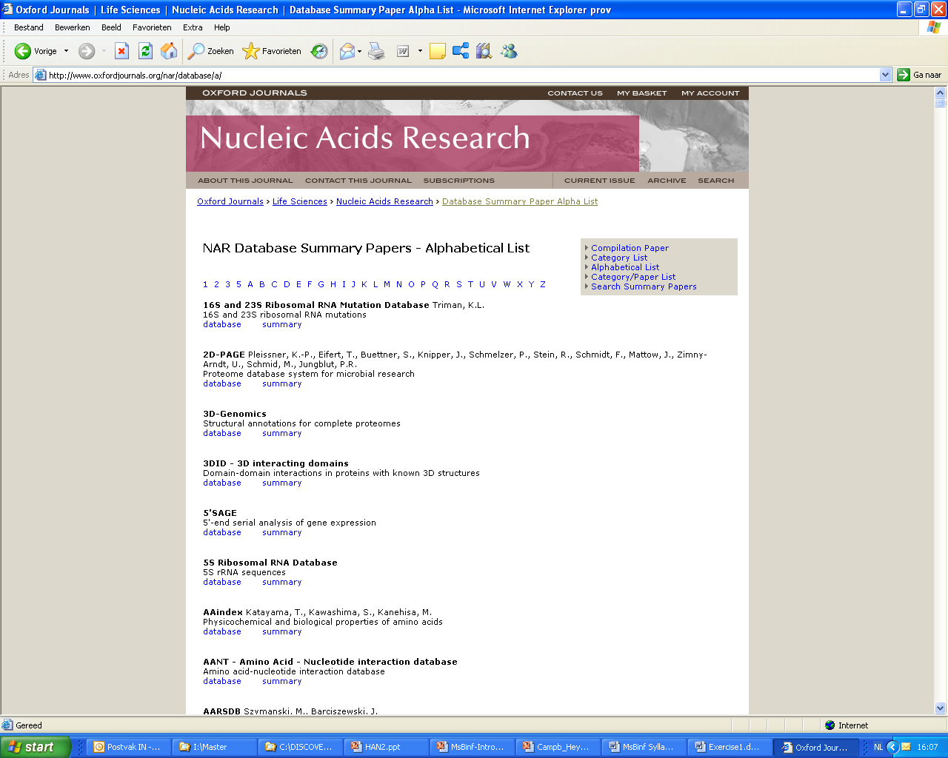
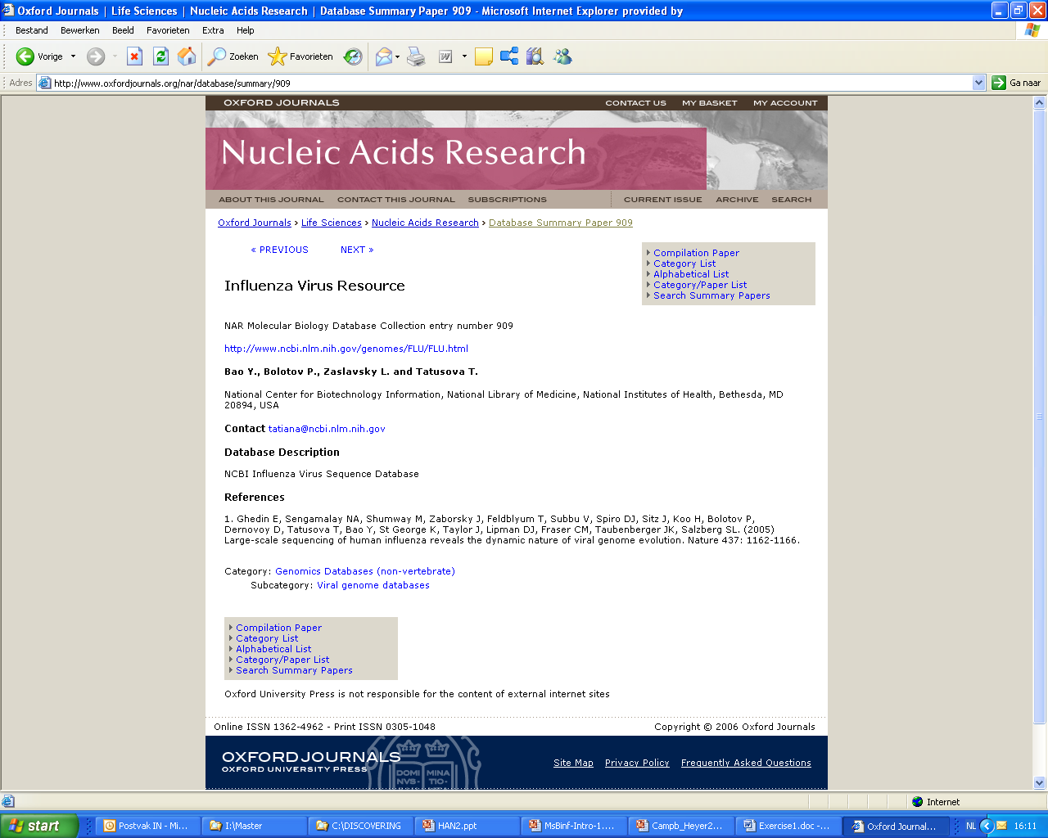
Database Summary @ NAR
http://www.oxfordjournals.org/nar/database/a/

Slide 12
Portals
EBI - http://www.ebi.ac.uk/services/proteins
Expasy - http://www.expasy.org/proteomics
NCBI - http://www.ncbi.nlm.nih.gov/guide/proteins/

Slide 13
Eiwit classificatie & annotatie
BLAST (hypothese mogelijke functie),
NCBI/Uniprot (sequenties met annotatie),
PubMed (literatuur via NCBI),
CDD (conserved domains database via NCBI),
GO (gene ontology),
Prosite (protein signatures),
Pfam (protein families, PSSM),
Interpro (protein families),
PDB (3D structuren),
CATH / SCOP (3D structuur classificatie)

Slide 14
Overzicht
Tools en databases
Annotatie en data kwaliteit
Eiwit translocatie
Predictie

Slide 15
Primary data + annotations
Annotations:
links
interpretation of data
citations
ancillary information which aids in interpreting sequence
automatically or manually added
error rate dependent on methodology and human interpretation
NP_000510 via http://www.ncbi.nlm.nih.gov/

Slide 16
Automated Annotation
initial analysis & annotation is usually automated,
e.g. the identification of similar sequences by alignment of all sequences in a database
Misleading analysis:
in the early stage of genome sequence annotation genes were predicted
sometimes there is no experimental data available to support the predictions
these genes and proteins are labeled as “hypothetical

Slide 17
Data Quality
incorrect data leads to erroneous conclusion
many experimental methods are applied to only small parts of the complete system
caution is required when extrapolating back to the complete cellular system
database information must include sufficient experimental details & references to published papers

Slide 18
Manually annotated data
Computer-based analysis is easily carried out but cannot produce annotation of high quality
human datasets annotation is more reliable but very time consuming
e.g. SwissProt is a manually curated database

Slide 19
Quality of Data
SwissProt (UniProt) / RefSeq (NCBI):
+ curated data (only entered by annotation experts)
+ higher quality, less errors
- does not contain all data available
GenBank, PDB:
+ everybody can submit data
- data is accepted the way it is submitted
Notes:
EMBL no human intervention
PDB no human intervention but there are some checks

Slide 20
Data Quality - conclusion
Databases often contain interpretation and links to relevant databases;
Incorrect data may lead to erroneous conclusions:
redundancy
checking data
human curation
updating data

Slide 21
Overzicht
Tools en databases
Annotatie en data kwaliteit
Eiwit translocatie
Predictie

Slide 22
Ontology
Organization of the complex data found in databases and merging data from various places is difficult when data are described using different terminology for each data.
Solution:
Ontologies: formal & explicit specifications of the terms & relationships between them.
Data consistency

Slide 23
Gene ontology (GO)
provides a controlled vocabulary that describes gene and gene-associated information
sharing a vocabulary such as GO between databases is a step forward unification of databases
GO: Cellular component
GO: Biological process
GO: Molecular function
http://www.geneontology.org/

Slide 24
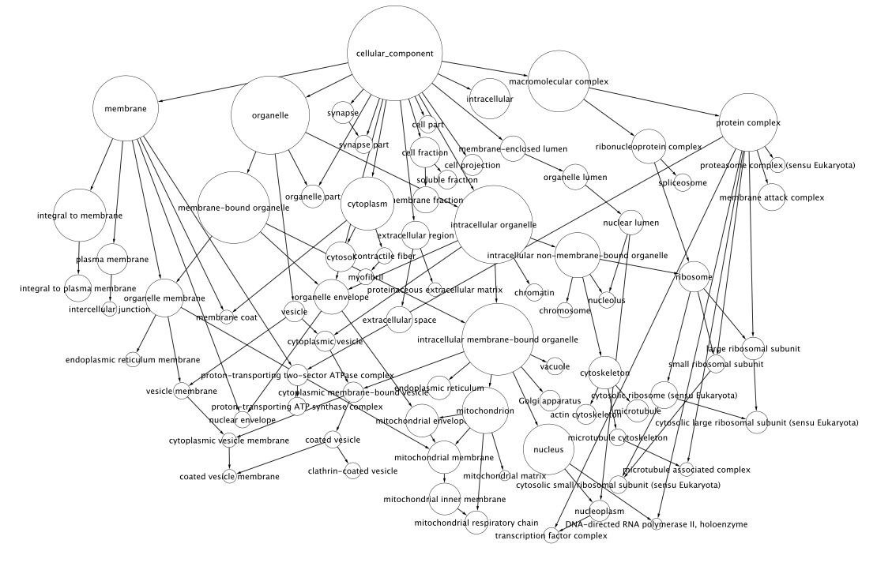
Ontology example – cellular component
http://academic.reed.edu/biology/professors/srenn/student%20projects/Renn_S-P_bioinformatics.html, 14-11-2012

Slide 25
GO-termen
Vaak een snelle indicatie voor:
Functie
Biologisch proces
Cellulaire locatie
Wordt gebruikt in veel databases (bv. Uniprot)
Je kunt ook je eiwit opzoeken op http://www.geneontology.org/

Slide 26
GO – Evidence codes
Denk na voordat je iets overneemt
Waar komt het vandaan?
Hoe betrouwbaar is deze bron?
http://www.geneontology.org/GO.evidence.shtml

Slide 27
Overzicht
Tools en databases
Annotatie en data kwaliteit
Eiwit translocatie
Predictie

Slide 28
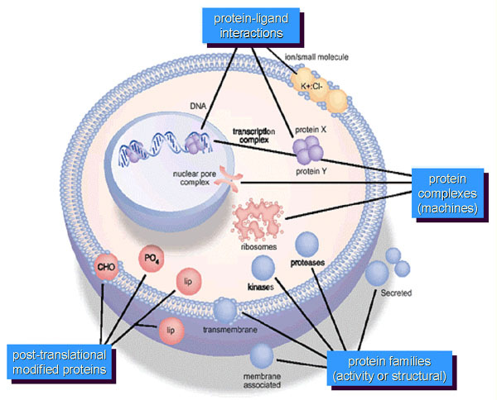
Wanneer is een proteine actief?
Protein-ligand interactions
Protein localisation
Protein-
protein interactions
Proteolytic
cleavage
Patterson & Aebersold, Nature Genetics (supp.), 33, 311 (2003)
Post-translational
modified proteins
Protein families
(activity or structural)
Notes:
Each protein can be post-translationally modified, which might lead to activation, inactivation or a different function of the protein. The same is true for proteolytic cleavage, where a small piece of the protein is cleaved from the protein. In addition, each protein is located in a special place in the cell. When it is brought to another location the function of the protein can change due to the presence of different binding partners. For example here, the protein ligand interactions. In the cytoplasm they will bind to each other the result of which is that the whole complex is brought to the nucleus where it can enhance gene expression. The same is true for protein-protein interactions. When a protein is in complex with a certain protein it can have function 1 and when it is in complex with another protein it can have function 2.

Slide 29
Folding and post-translational processing
Often translation is not sufficient to make a functional protein
Polypeptide chains are modified after translation
Completed proteins are targeted to specific sites in the cell
Notes:
29

Slide 30
Post-translational processing
vouwing mbv chaperones (HSP70)
modificaties aminozuren (fosforylatie, glycosylatie, methylatie, isoprenylatie, binding biotine, binding heme groep)
proteolytic processing (o.a. verwijderen N-terminaal signaal peptide)
vorming van disulfide bruggen
translocatie
eiwit-eiwit interacties

Slide 31
Intracellulair eiwit transport en detectie
Hoe komen eiwitten naar hun intra- of extracellulaire bestemming?

Slide 32
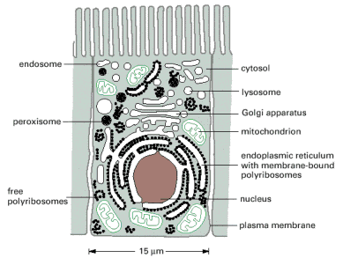
In welke compartimenten vindt eiwitsynthese plaats?
http://www.unitus.it/scienze/corsonew/lezione11.html

Slide 33
Targeting Polypeptides to Specific Locations
Two populations of ribosomes are evident in cells: free ribsomes (in the cytosol) and bound ribosomes (attached to the ER)
Free ribosomes mostly synthesize proteins that function in the cytosol
Bound ribosomes make proteins of the endomembrane system and proteins that are secreted from the cell
Ribosomes are identical and can switch from free to bound
Notes:
33

Slide 34
Hoe komt een net gemaakt eiwit op de plaats van zijn bestemming?
Transportmechanismen zorgen voor transport van eiwit naar doelbestemming:
- hulpeiwitten transporteren eiwit naar plaats van bestemming
- energie nodig
- eiwit moet herkenbaar zijn: signaal sequentie dragen

Slide 35
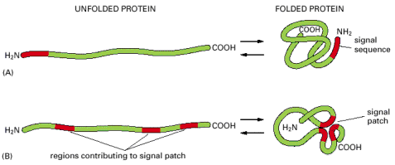
Signal sequence en signal patch
- Eiwit draagt markering (vergelijkbaar met een adres):
(A) The signal sequence: single discrete stretch of amino acid sequence, exposed in folded protein
(B) A signal patch: formed by the juxtaposition of amino acids from regions that are physically separated before the protein folds
http://greatcourse.cnu.edu.cn/xbfzswx/wlkc/kcxx/7English(31234048Bytes).htm

Slide 36
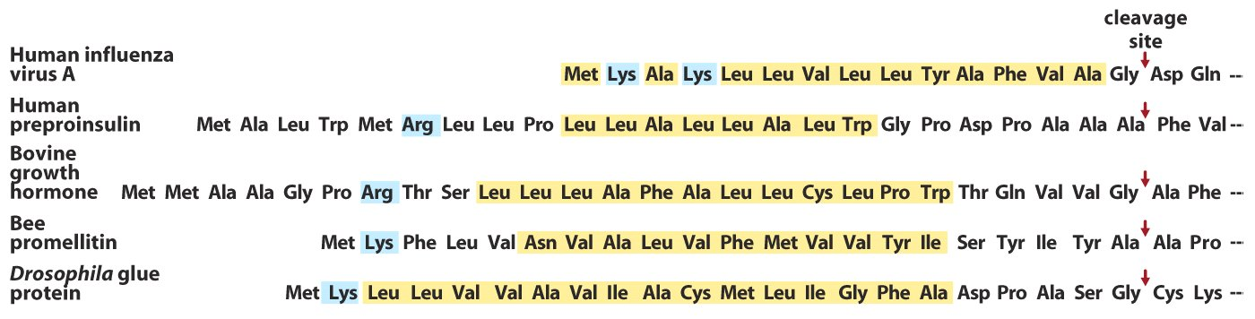
Signaal sequentie voor transmembraan transport
Signaal sequentie ~13-36 aminozuren
10-15 hydrofobe aminozuren
1 of meer positief geladen aminozuren vlak bij N-terminus voorafgaand aan de hydrofobe aa.
Een korte polaire sequentie na de hydrofoba aa. Vlak bij de knipsite veelal aa. met een korte zijketen (Ala)
http://greatcourse.cnu.edu.cn/xbfzswx/wlkc/kcxx/7English(31234048Bytes).htm

Slide 37
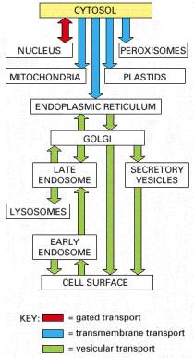
Drie intracellulaire transportmechanismen
- Gated transport
- Vesiculair transport
- Transmembrane transport
http://www.unitus.it/scienze/corsonew/lezione11.html

Slide 38
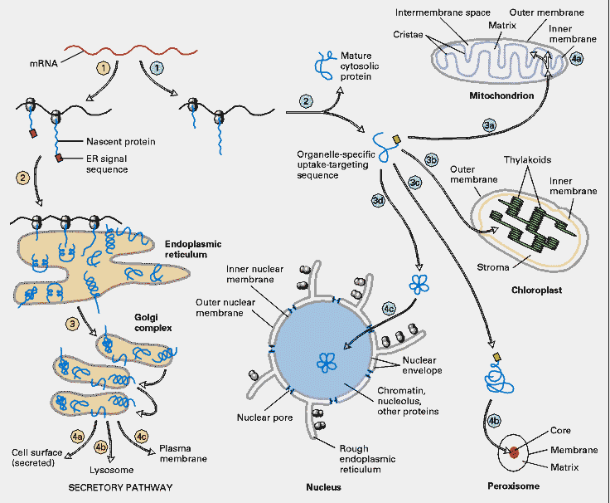
http://www.unitus.it/scienze/corsonew/lezione11_files/sorting_detailed.gif
Protein targeting

Slide 39
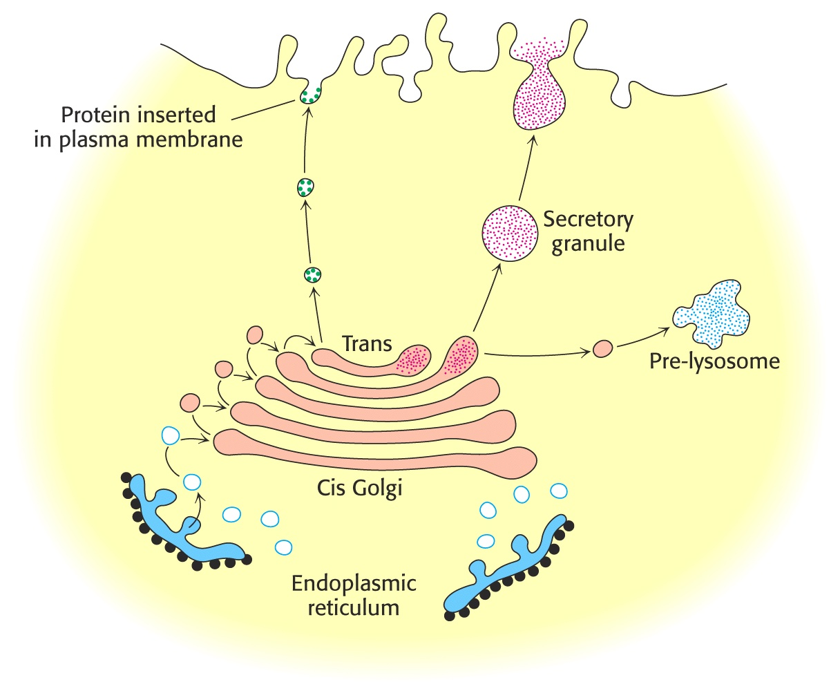
Vesiculair transport
- Eiwitten die aan ER-gebonden ribosomen gesynthetiseerd worden, worden getransporteerd naar het membraan of worden gesecreteerd.
- Signaal sequentie wordt afgeknipt na transport
http://greatcourse.cnu.edu.cn/xbfzswx/wlkc/kcxx/7English(31234048Bytes).htm

Slide 40
Secretie route
Eiwit synthese begint altijd in het cytosol
Synthese eindigt in het cytosol, behalve als een signaal peptide het ribosoom signaleert om aan het ER te binden
Een signal-recognition particle (SRP) bind aan het signaal peptide
Het SRP brengt het signal peptide + ribosome naar het ER
Notes:
40

Slide 41
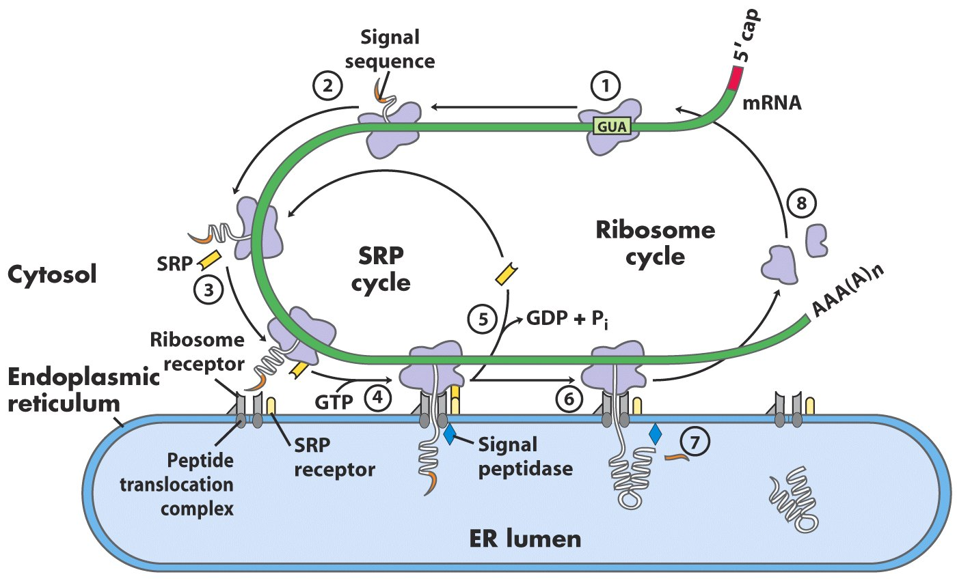
Translocatie naar het ER
GTP-
+ GTP
+ GTP
Lehninger fig 27.38
Notes:
1 – The targeting pathway begins with initiation of protein synthesis on free ribosomes
2 – The signal sequence appears early in the synthetic process, because it is at the amino terminus which is synthesized first.
3 – The signal sequence and the ribosome are bound by the large signal recognition particle (SRP). SRP binds GTP and halts elongation of the polypeptide when it is about 70 a.a. long and the signal sequence has completely emerged from the ribosome
4 – The GTP-bound SRP now directs the ribosome + mRNA + polypeptide to GTP-bound SRP receptors in the cytosolic face of the ER. The polypeptide is delivered to the peptide translocation complex in the ER, which interacts directly with the ribsome.
5 – SRP dissociates from the ribosome, accompanied by hydrolysis of GTP in both SRPand the SRP receptor.
6 – Elongation of the polypeptide resumes with the ATP driven translocation complex feeding the growing polypeptide to the ER lumen.
7 – The signal sequence is removed by a signal peptidase within the ER lumen
8 – The ribosome dissociates and is recycled.

Slide 42
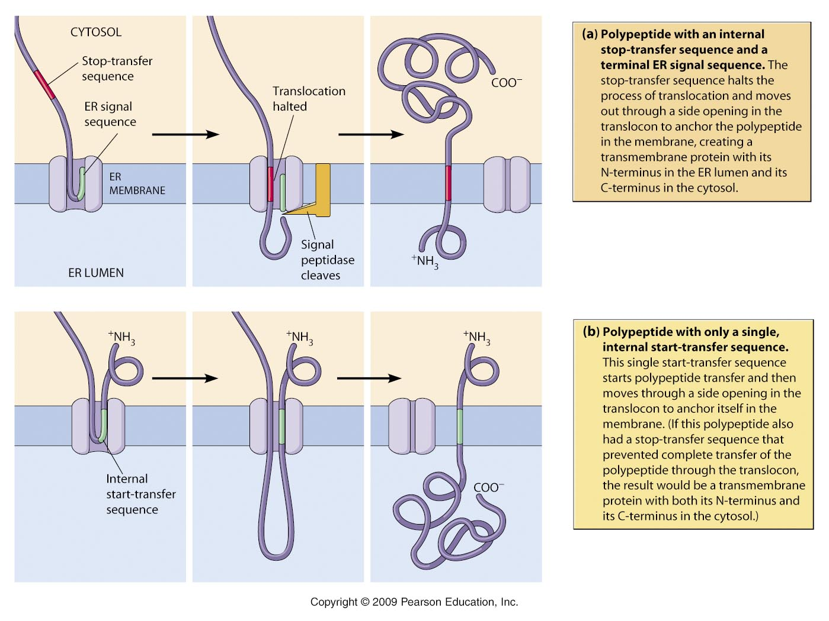
http://www.mun.ca/biology/desmid/brian/BIOL2060/BIOL2060-22/2217.jpg

Slide 43
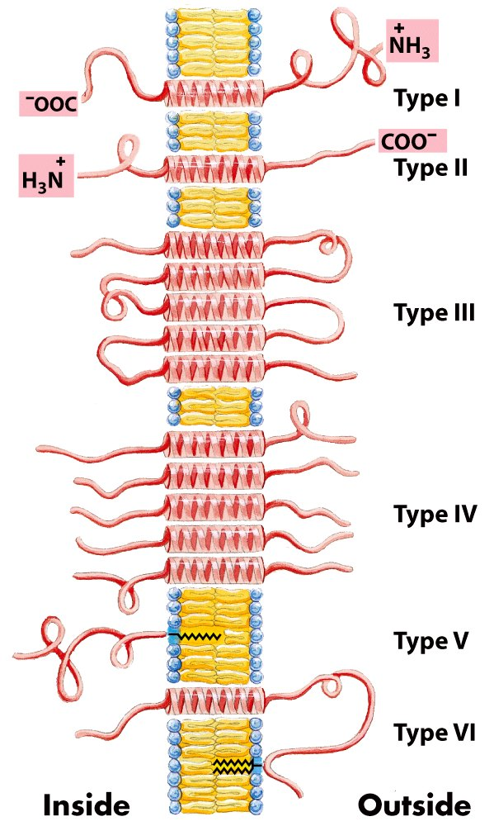
Integral membrane proteins
Lehninger fig 11.8

Slide 44
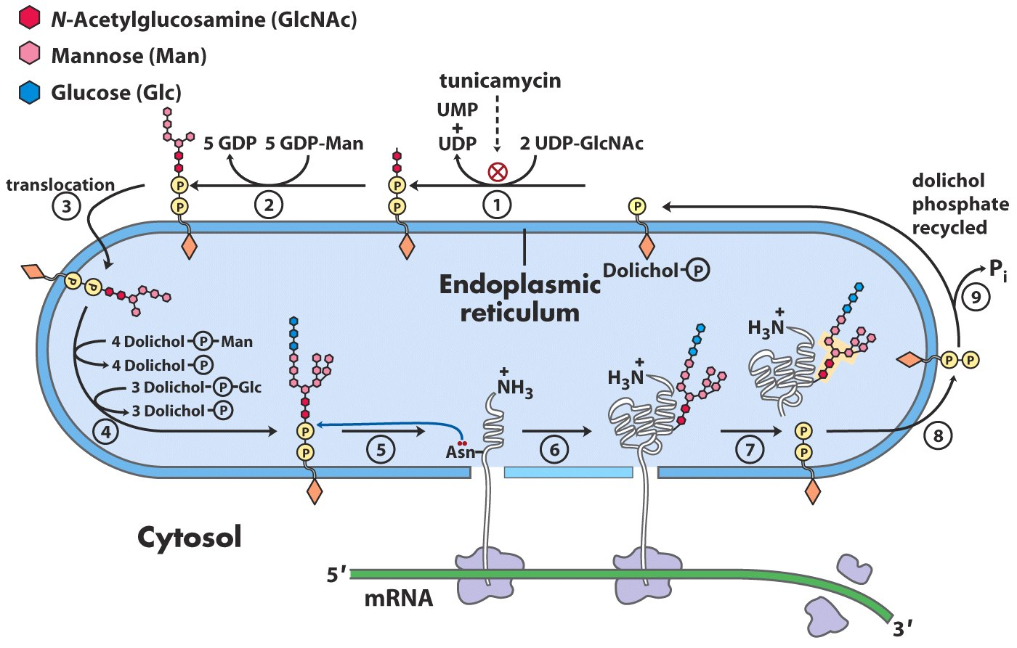
Posttranslation modifications in the ER
Disulfide bridges - Folding (HSP70) - N-linked Glycosylation
14-residue core
oligosaccharide
Transferase
No glycosylation of cytosolic proteins !!
Lehninger fig 27.39

Slide 45
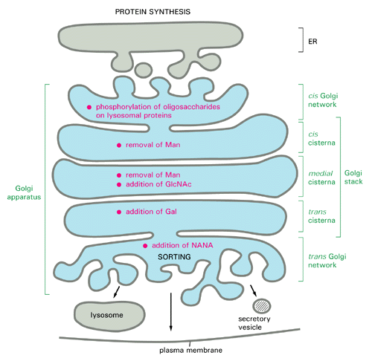
Post-translationele modificaties in het Golgi
NANA: N-Acetyl neuraminic acid
http://www.cytochemistry.net/cell-biology/golgi.htm

Slide 46
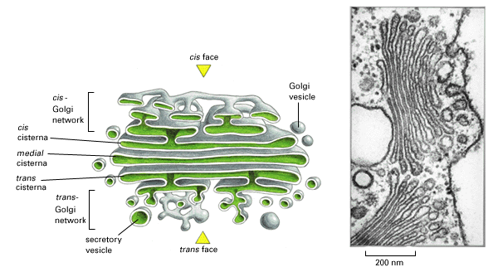
Golgi
http://greatcourse.cnu.edu.cn/xbfzswx/wlkc/kcxx/7English(31234048Bytes).htm

Slide 47
Vraag
Hoeveel transmembraan domeinen heb je nodig om de N-terminus binnen te krijgen en de C-terminus buiten?
En allebei aan de buitenkant?

Slide 48
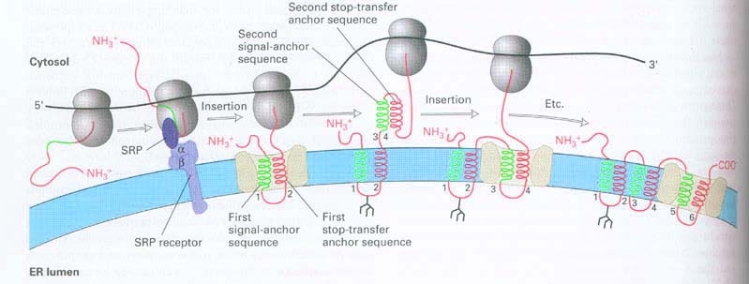
http://greatcourse.cnu.edu.cn/xbfzswx/wlkc/kcxx/kcxx-7.htm

Slide 49
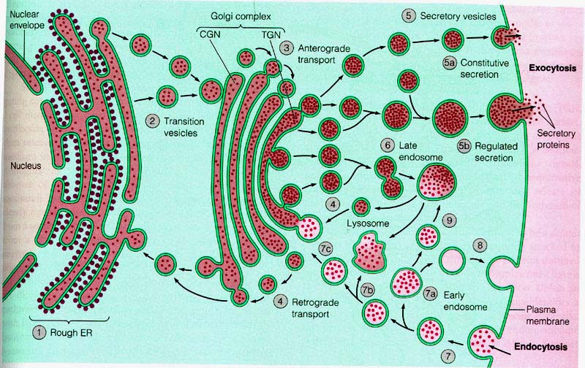
http://www.lookfordiagnosis.com/mesh_info.php?term=Exocitosis

Slide 50
http://www.unitus.it/scienze/corsonew/lezione11_files/sorting_detailed.gif
Protein targeting

Slide 51
Protein sorting
Some typical signal sequences:
Import into nucleus: -Pro-Pro-Lys-Lys-Lys-Arg-Lys-Val-
Export from nucleus: -Leu-Ala-Leu-Lys-Leu-Ala-Gly-Leu-Asp-Ile-
Import into mitochondris: +H3N-Met-Leu-Ser-Leu-Arg-Gln-Ser-Ile-Arg-Phe-Phe-Lys-Pro-Ala-Thr-Arg-Thr-Leu-Cys-Ser-Ser-Arg-Tyr-Leu-Leu-
Import into peroxisomes: -Ser-Lys-Leu-COO-
Import into ER: +H3N-Met -Met-Ser-Phe-Val-Ser-Leu-Leu-Leu-Val-Gly-Ile-Leu-Phe-Try-Ala-Thr-Glu-Ala-Glu-Gln-Leu-Thr-Lys-Cys-Glu-Val-Phe-Gln-
Return to ER: -Lys-Asp-Glu-Leu--COO-
Some characteristic features of the differences of the different classes of signal sequences are highlighted in color. Where they are known to be important for the function of the signal sequence, positively charged amino acids are shown in blue. Similarly, important hydrophobic amino acids are shown in blue . +H3N indicates the N-terminus of a protein; COO- indicates the C-terminus.

Slide 52
Vraag
Aan het gen voor een eukaryoot polypeptide van 300 a.a. met een intern nucleair lokalisatie signaal (NLS, pos. 150), wordt via genetische modificatie een N-terminale signaal sequentie toegevoegd die wordt herkend door het SRP.
Waar bevindt dit eiwit zich?

Slide 53
Overzicht
Tools en databases
Annotatie en data kwaliteit
Eiwit translocatie
Predictie

Slide 54
Transmembraan domeinen
Eigenschappen
Voorspellen
- op basis van homologie
- ab initio

Slide 55
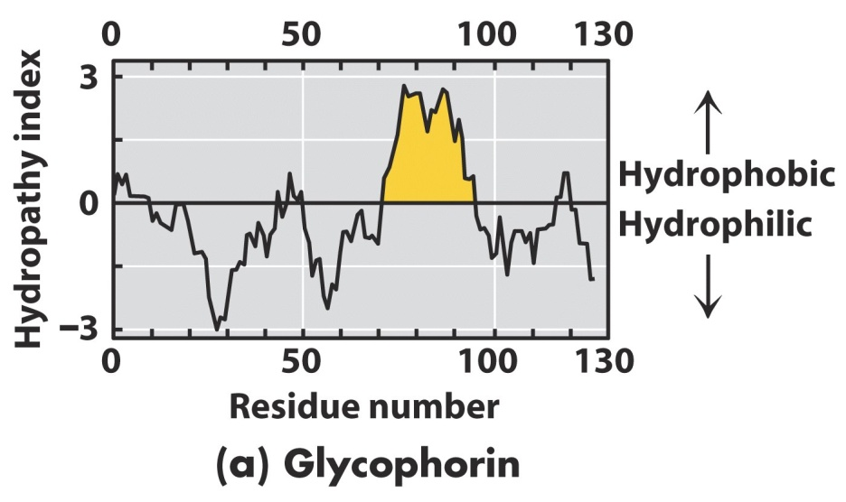
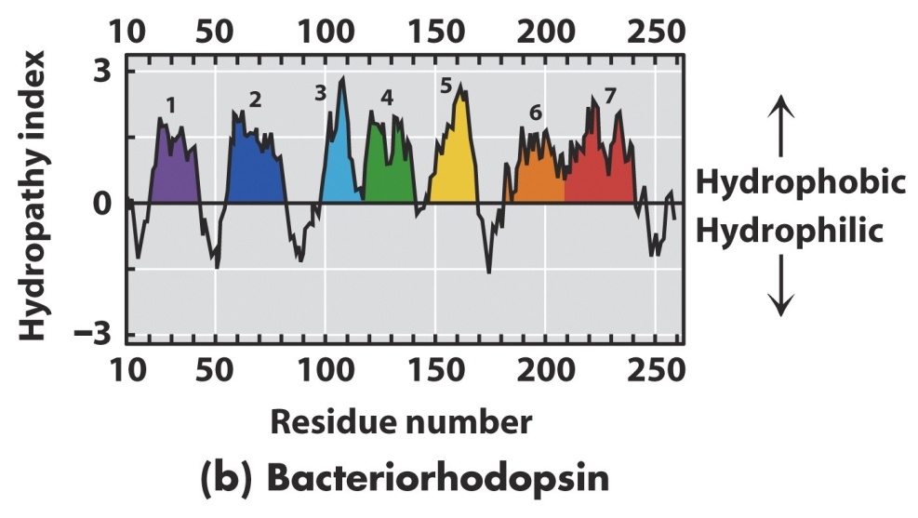
Voorspelling membraan topologie
20-25 a.a. alpha helix = ongeveer 3 nm (30 Å)
Hydrophathy index = overall hydrophobicity of a sequence of a.a.
calculated per window of 7-20 a.a.
Lehninger fig 11.11

Slide 56
Hoe verifieer je een predictie?

Slide 57
Bronnen
Lehninger, Biochemistry, 5th edition. ISBN 9780716743392
Figuren van internet geraadpleegd op 16-11-2013 en 12-11-2014
Copyright I. Paffen, HAN

